Slide 1
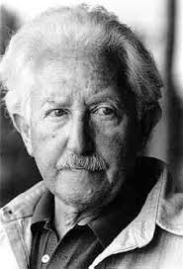
Erikson’s stages of Psychological Development

Slide 2
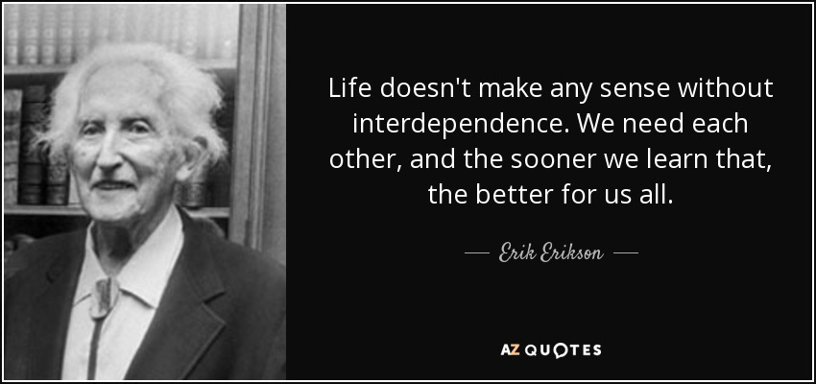

Slide 3
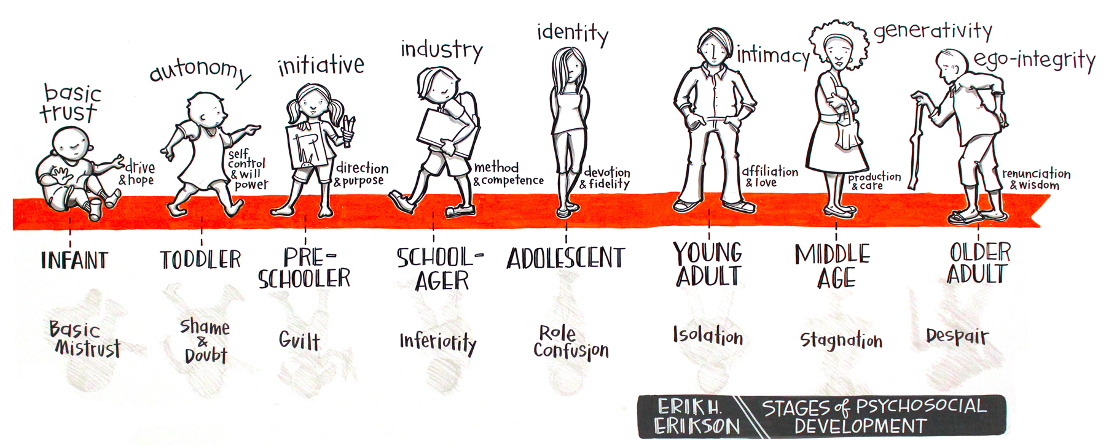

Slide 4
Erik Homberger Erikson was born in 1902 near Frankfort, Germany to Danish parents.
Erikson developed eight psychosocial stages in which humans develop through throughout their entire life span.
During each of Erikson's eight development stages, two conflicting ideas must be resolved successfully in order for a person to become a confident, contributing member of society. Failure to master these tasks leads to feelings of inadequacy.
He can be compared to Sigmund Freud in that he claimed that humans develop in stages.
Each person progresses through life, from infancy up until death, and confront different challenges that can either be mastered or that can lead to difficulties.
Erikson didn’t believe that mastering each stage was necessary in order to move on to the next

Slide 5
Various terms are used to describe Erikson's model, for example Erikson's biopsychosocial or bio-psycho-social theory (bio refers to biological, which in this context means life).
Erikson's human development cycle or life cycle, and variations of these. All refer to the same eight stages psychosocial theory, it being Erikson's most distinct work and remarkable model.
The word 'psychosocial' is Erikson's term, effectively from the words psychological (mind) and social (relationships).
Erikson believed that his psychosocial principle is genetically inevitable in shaping human development. It occurs in all people.
Erikson stressed his work was a ‘tool to think with rather than a factual analysis’. Its purpose then is to provide a framework within which development can be considered rather than testable theory.

Slide 6
There are three key components of Erikson’s theory:
Ego identity: Our continually changing sense of self that emerges due to our social interactions and experiences.
Ego strength: This develops when people successfully master each stage of development.
Conflict: At each stage of development, people face some type of conflict that serves as a turning point in the developmental process.

Slide 7
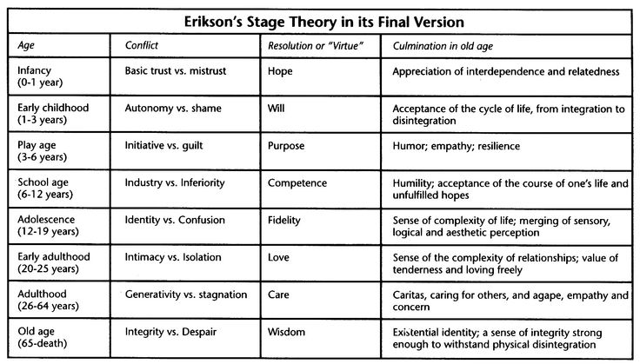

Slide 8
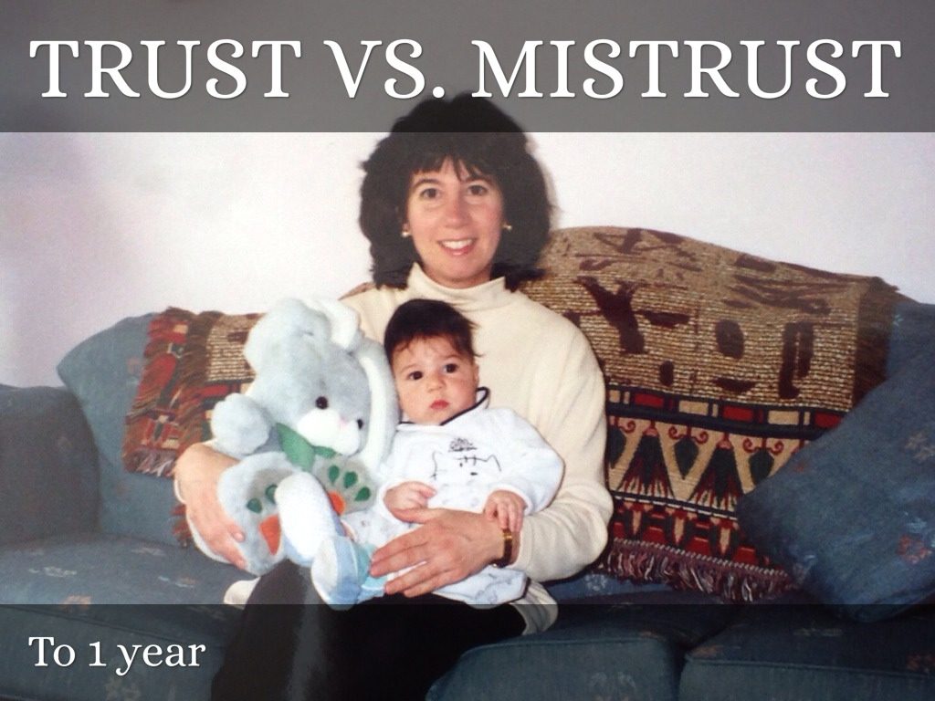

Slide 9
Trust v Mistrust 'To get' 'To give in return' (To receive and to give in return. Trust is reciprocal - maybe karma even..)

Slide 10
Is the world a safe place or is it full of unpredictable events and accidents waiting to happen?
The infant will develop a healthy balance between trust and mistrust if fed and cared for and not over-indulged or over-protected.
If the care the infant receives is consistent, predictable and reliable, they will develop a sense of trust which will carry with them to other relationships, and they will be able to feel secure even when threatened.
If the care has been harsh or inconsistent, unpredictable and unreliable, then the infant will develop a sense of mistrust and will not have confidence in the world around them or in their abilities to influence events. It may result in anxiety, heightened insecurities, and an over feeling of mistrust in the world around them
Success in this stage will lead to the virtue of hope. Failing to acquire the virtue of hope will lead to the development of fear.
Life event: Feeding

Slide 11
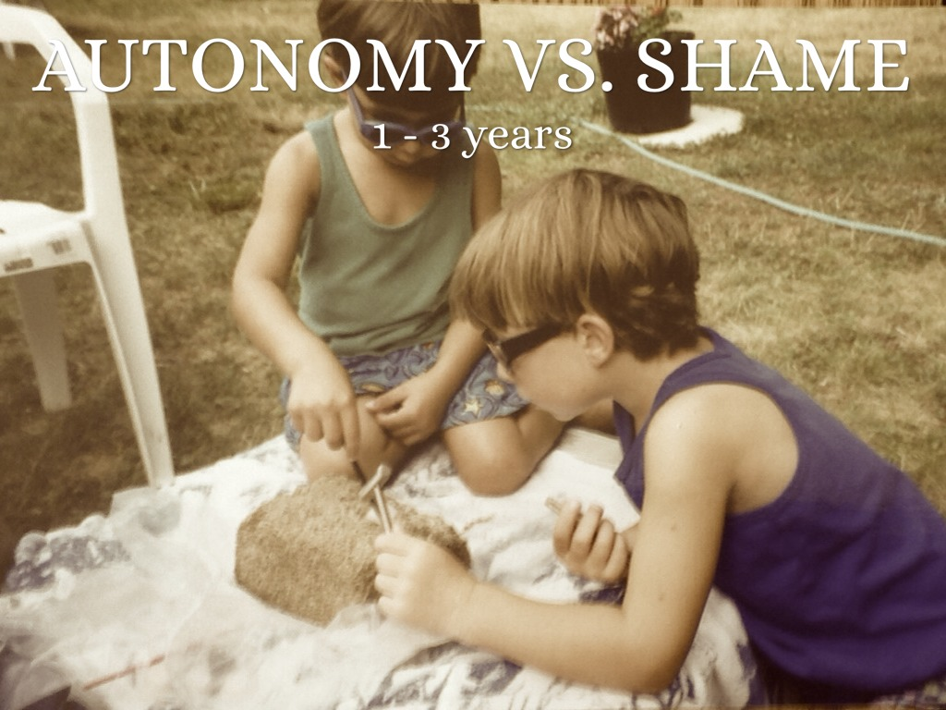

Slide 12
Autonomy v Shame & Doubt 'To hold on' 'To let go' (To direct behaviour outward or be retentive. Of course very Freudian...)

Slide 13
Autonomy means self-reliance. This is independence of thought, and a basic confidence to think and act for oneself.
Shame and Doubt mean what they say, and obviously inhibit self-expression and developing one's own ideas, opinions and sense of self.
Children begin to assert their independence, by walking away from their mother, picking which toy to play with, and making choices about what they like to wear, to eat, etc.
Erikson states it is critical that parents allow their children to explore the limits of their abilities within an encouraging environment which is tolerant of failure.
If children in this stage are encouraged and supported in their increased independence, they become more confident and secure in their own ability to survive in the world.
If children are criticised, overly controlled, or not given the opportunity to assert themselves, they begin to feel inadequate in their ability to survive, and may then become overly dependent upon others, lack self-esteem, and feel a sense of shame or doubt in their own abilities.
Success in this stage will lead to the virtue of will.
Life event: Toilet training

Slide 14
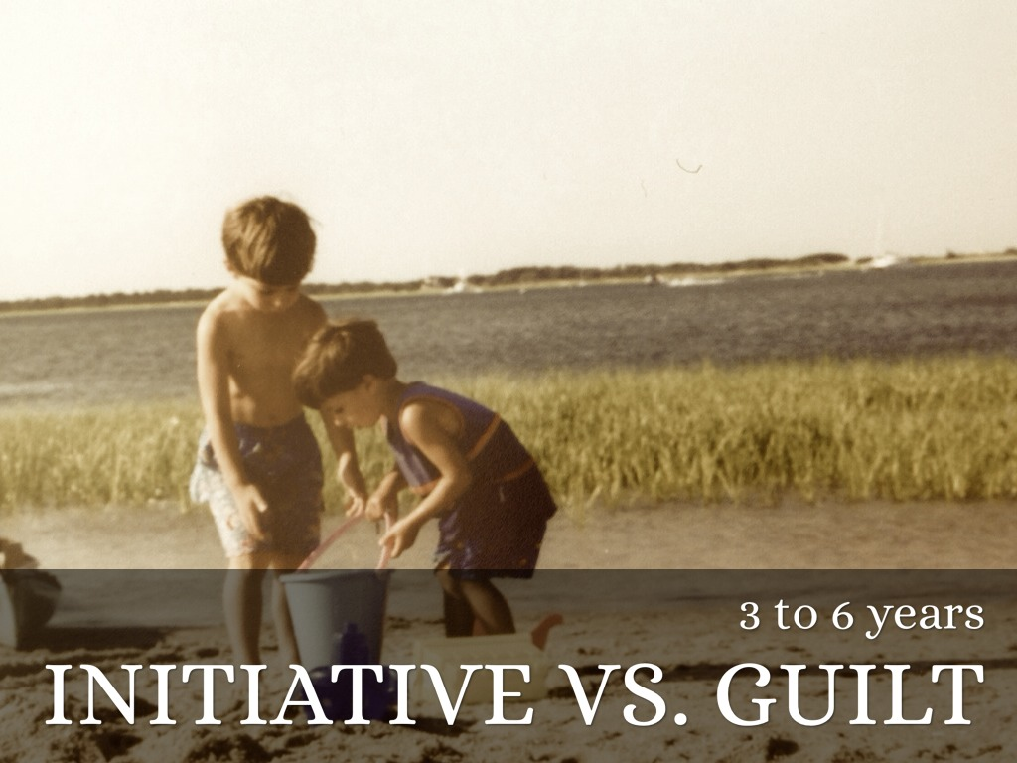

Slide 15
Initiative v Guilt
'To make (= going after)' 'To "make like" (= playing)' (To make and complete things, and to make things together. To pursue ideas, plans)

Slide 16
Initiative is the capability to devise actions or projects, and a confidence and belief that it is okay to do so, even with a risk of failure or making mistakes.
Guilt means what it says, and in this context is the feeling that it is wrong or inappropriate to instigate something of one's own design.
Children begin to plan activities, make up games, and initiate activities with others. If given this opportunity, children develop a sense of initiative, and feel secure in their ability to lead others and make decisions
If this tendency is squelched, either through criticism or control, children develop a sense of guilt. They may feel like a nuisance to others and will therefore remain followers, lacking in self-initiative.
The fear of being admonished or accused of being stupid becomes a part of the personality. "If I don't initiate or stick my neck out I'll be safe.." (from feeling guilty and bad).
Parents, carers and older siblings have a challenge to get the balance right between giving young children enough space and encouragement so as to foster a sense of purpose and confidence, but to protect against danger, and also to enable a sensible exposure to trail and error, and to the consequences of mistakes, without which an irresponsible or reckless tendency can develop.
A healthy balance between initiative and guilt is important. Success in this stage will lead to the virtue of purpose.
Life event: Independence

Slide 17
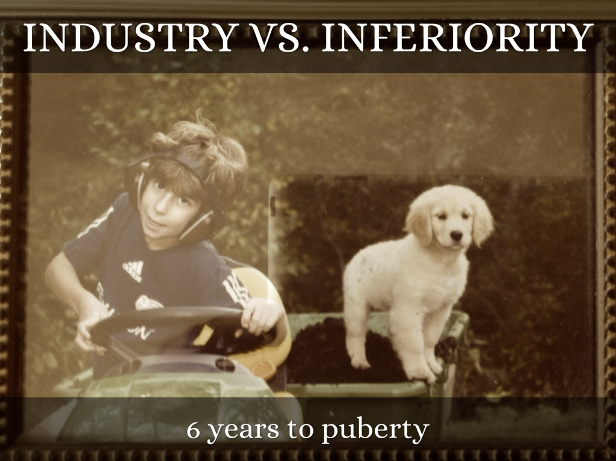

Slide 18
Industry v Inferiority 'To make (= going after)' 'To "make like" and complete things, and to make things together' (To initiate projects or ideas, and to collaborate and cooperate with others to produce something.)

Slide 19
Industry here refers to purposeful or meaningful activity. It's the development of competence and skills, and a confidence to use a 'method', and is a crucial aspect of school years experience.
At this stage, teachers begin to take an important role in the child’s life as they teach the child specific skills.
The child’s peer group will gain greater significance and will become a major source of the child’s self esteem.
If children are encouraged and reinforced for their initiative, they begin to feel industrious and feel confident in their ability to achieve goals.
If this initiative is not encouraged, if it is restricted by parents or teacher, then the child begins to feel inferior, doubting his own abilities and therefore may not reach his or her potential.
Some failure may be necessary so that the child can develop some modesty. Yet again, a balance between competence and modesty is necessary.
Success in this stage will lead to the virtue of competence.
Life event: School

Slide 20
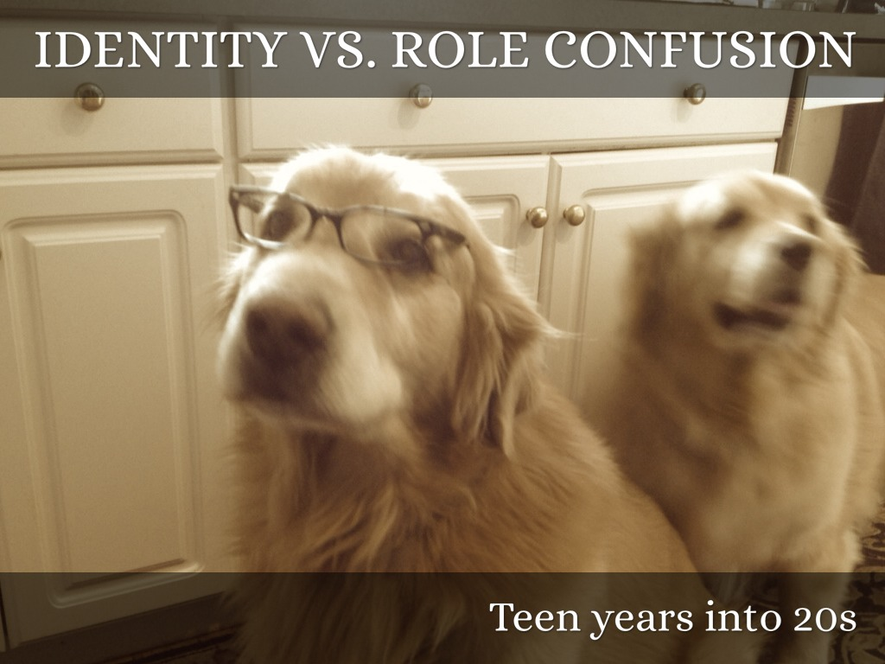

Slide 21
Identity v Role Confusion 'To be oneself (or not to be)' 'To share being oneself' (To be yourself and to share this with others. Affirmation or otherwise of how you see yourself)

Slide 22
Identity means essentially how a person sees themselves in relation to their world. It's a sense of self or individuality in the context of life and what lies ahead.
Role Confusion is the negative perspective - an absence of identity - meaning that the person cannot see clearly or at all who they are and how they can relate positively with their environment.
This stage coincides with puberty or adolescence, and the reawakening of the sexual urge whose dormancy typically characterises the previous stage.
This is a major stage in development where the child has to learn the roles they will occupy as an adult.
Erikson claims that the adolescent may feel uncomfortable about their body for a while until they can adapt and “grow into” the changes.
Failure to establish a sense of identity within society ("I don’t know what I want to be when I grow up") can lead to role confusion. Role confusion involves the individual not being sure about themselves or their place in society.
In response to role confusion or identity crisis an adolescent may begin to experiment with different lifestyles (e.g. work, education or political activities).
Pressuring someone into an identity can result in rebellion in the form of establishing a negative identity, and in addition to this feeling of unhappiness.
Success in this stage will lead to the virtue of fidelity.
Life event: Peer relationships

Slide 23


Slide 24
Intimacy vs Isolation 'To loose oneself or to find oneself in another’
(Reciprocal love for and with another person)

Slide 25
Intimacy means the process of achieving relationships with family and marital or mating partner(s).
Isolation conversely means being and feeling excluded from the usual life experiences of dating and mating and mutually loving relationships.
During this stage we begin to share ourselves more intimately with others. We explore relationships leading toward longer term commitments with someone other than a family member.
Successful completion of this stage can lead to comfortable relationships and a sense of commitment, safety, and care within a relationship.
Avoiding intimacy, fearing commitment and relationships can lead to isolation, loneliness, and sometimes depression.
Success in this stage will lead to the virtue of love.
Life event: Love relationships

Slide 26
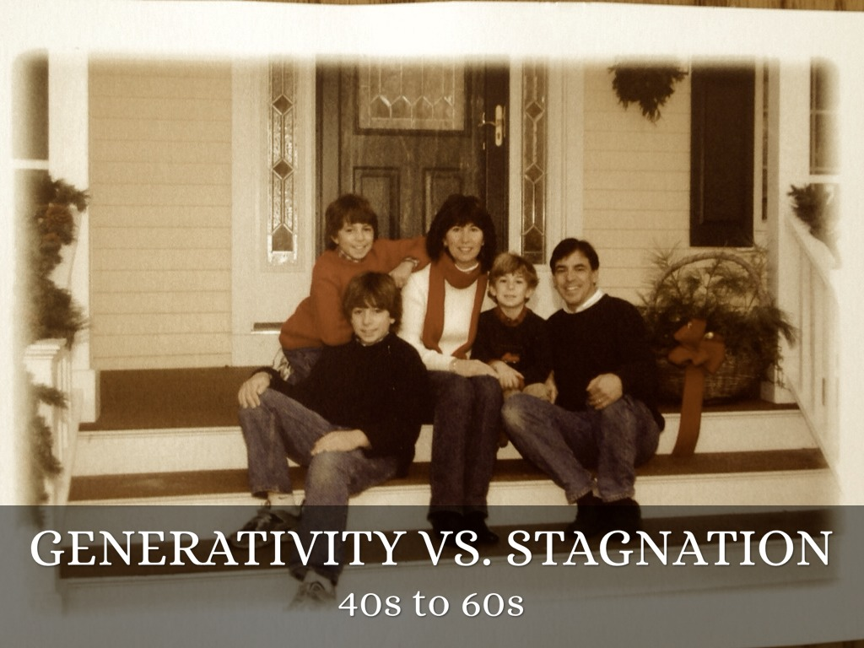

Slide 27
Generativity v Stagnation 'To make be' 'To take care of' (Unconditional, non-reciprocating care of one's children, or other altruistic outlets)

Slide 28
Generativity derives from the word generation, as in parents and children, and specifically the unconditional giving that characterises positive parental love and care for their offspring.
During this stage we establish our careers, settle down within a relationship, begin our own families and develop a sense of being a part of the bigger picture.
We give back to society through raising our children, being productive at work, and becoming involved in community activities and organizations.
Stagnation is an extension of intimacy which turns inward in the form of self-interest and self-absorption. It's the disposition that represents feelings of selfishness, self-indulgence, greed, lack of interest in young people and future generations, and the wider world. Erikson later used the term 'Self-Absorption' instead of 'Stagnation' and then seems to have settled in later work with the original 'Stagnation'.
Success in this stage will lead to the virtue of care.
Life event: Parenting

Slide 29
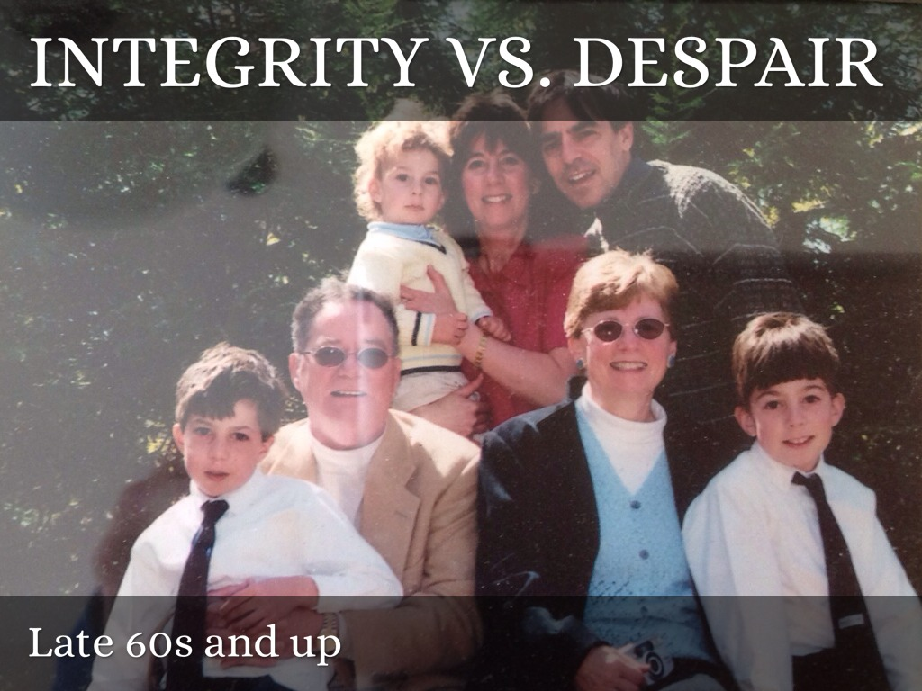

Slide 30
Integrity v Despair ''To be, through having been’ 'To face not being' (To be peaceful and satisfied with one's life and efforts, and to be accepting that life will end)

Slide 31
During the stage we become senior citizens, we tend to slow down our productivity, and explore life as a retired person. It is during this time that we contemplate our accomplishments and are able to develop integrity if we see ourselves as leading a successful life.
Integrity means feeling at peace with oneself and the world. No regrets or recriminations.
The linking between the stages is perhaps clearer here than anywhere: people are more likely to look back on their lives positively and happily if they have left the world a better place than they found it - in whatever way, to whatever extent. There lies Integrity and acceptance. Despair and/or 'Disgust' (i.e., rejective denial, or 'sour grapes' feeling towards what life might have been) represent the opposite disposition: feelings of wasted opportunities, regrets, wishing to be able to turn back the clock and have a second chance.
Success in this stage will lead to the virtue of wisdom. Wisdom enables a person to look back on their life with a sense of closure and completeness, and also accept death without fear.
Life event: Reflection on and acceptance of one’s life

Slide 32
Limitations of Erikson
Erikson’s theory has good face validity. Many people find that they can relate to his theories about various stages of the life cycle through their own experiences.
Erikson is rather vague about the causes of development. What kinds of experiences must people have in order to successfully resolve various psychosocial conflicts and move from one stage to another? The theory does not have a universal mechanism for crisis resolution.
Erikson (1964) acknowledges his theory is more a descriptive overview of human social and emotional development that does not adequately explain how or why this development occurs. For example, Erikson does not explicitly explain how the outcome of one psychosocial stage influences personality at a later stage.
Although support for Erikson's stages of personality development exists (McAdams, 1999), critics of his theory provide evidence suggesting a lack of discrete stages of personality development (McCrae & Costa, 1997).

Slide 33
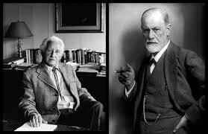
Freud vs Erikson

Slide 34
Freud's influence on Erikson's theory
Erikson's psychosocial theory drew from and extended the ideas of Sigmund Freud and Freud's daughter Anna Freud, and particularly the four (or five, depending on interpretation) Freudian stages of development.
Freud's concepts, while influential on Erikson, are not however fundamental to Erikson's theory, which stands up perfectly well in its own right.
Part of Erikson's appeal is that he built on Freud's ideas in a socially meaningful and accessible way.
Some of Freud's theories by their nature tend attract a lot of attention and criticism - as sex, breasts, genitals, and bodily functions generally do - and if you are distracted or put off by these references then ignore them, because they are not crucial for understanding and using Erikson's model.

Slide 35
Erikson’s theory bears some resemblances to Freud’s psychosexual stage theory, but with some key differences.
Freud focused on the influence of the id, while Erikson focused on the ego.
Freud believed that personality was largely shaped by the time a child reached age five, while Erikson’s theory spans the entire lifespan.
Freud stressed the importance of childhood experiences and unconscious desires, Erikson placed a greater emphasis on the role of social and cultural influences.
Erikson emphasized the role of culture and society and the conflicts that can take place within the ego itself, whereas Freud emphasized the conflict between the id and the superego.

Slide 36
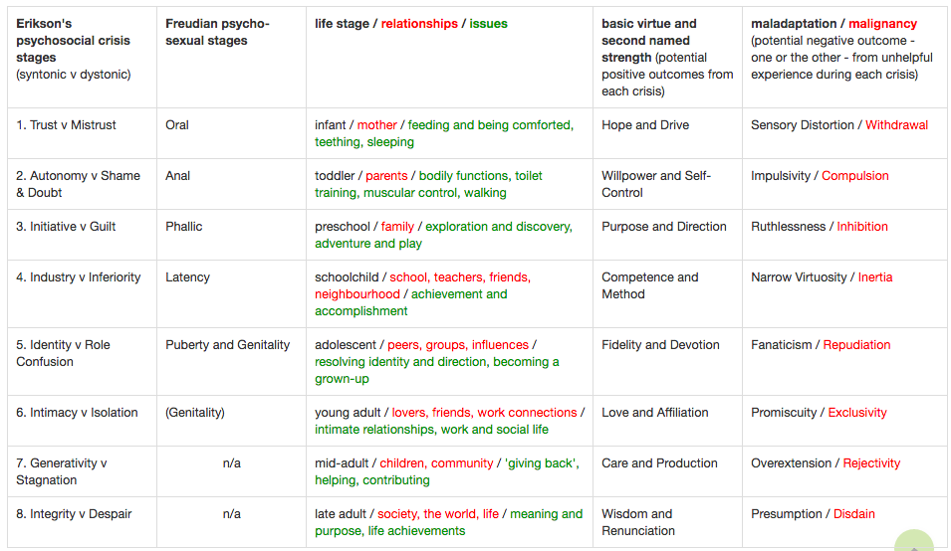
Erikson and Freud side by side

Slide 37
Further Reading
http://www.simplypsychology.org/Erik-Erikson.html
http://www.explorepsychology.com/eriksons-eight-stages-of-psychosocial-development/
http://www.businessballs.com/erik_erikson_psychosocial_theory.htm#erikson_psychosocial_theory_summary

